Slide 1

Library Management System (LMS)
Presented by Shubham Ruhal, Vaibhav, Ajay, Anurag

Slide 2

Introduction to LMS
Web-based Platform
Accessible from any device with internet
Backend Framework
Django for API and data management
Frontend Framework
React for dynamic and responsive UI
Core Functions
Manage books, users, and transactions

Slide 3
Key Features
Book Management
Transactions
User Security
Add, remove, list books seamlessly
Issue and return functionality
Authentication and user control
Media Support
Responsive Design
Upload and display book cover images
Optimized for multiple devices

Slide 4
Tech Stack Overview
Backend
Frontend
Version Control
Django & Django REST Framework
React with TypeScript
Git for code management
SQLite Database
Tailwind CSS for styling
GitHub for repository hosting
Django Authentication
API interaction with axios

Slide 5
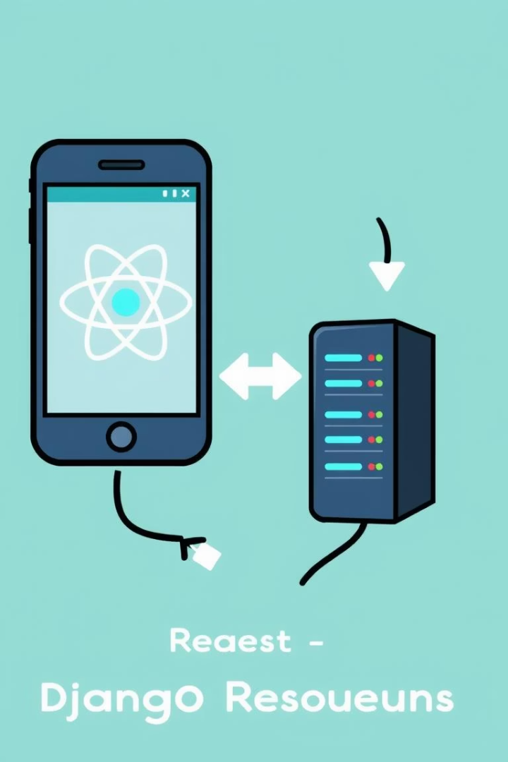



System Architecture
Frontend
React communicates through REST API
Backend
Django ORM manages database operations
Authentication
Handled via Django's built-in auth system

Slide 6
Database Design
Book Model Fields
User Model
title, author, description
Utilizes Django’s built-in user model features
published_date
is_issued, issued_to, issued_date
cover_image

Slide 7

Backend Code Structure
Models
Serializers
Define data structure in models.py
Convert models to JSON in serializers.py
Views
API endpoints in views.py using Django REST

Slide 8
Frontend Code Overview
BookList.tsx
AddBook.tsx
api.ts
Displays all books with status and cover images
Form for adding new books, including image upload
Handles communication with backend API endpoints

Slide 9





Challenges & Future Improvements
File Upload Issues
Authentication
Frontend-Backend Sync
Ensuring secure access control
Handling large image files securely
Maintaining consistent state
Planned Features
Search & Filter
Role-based Access
Email Notifications
Analytics Dashboard

Slide 10

Conclusion & Q&A
LMS offers a scalable, user-friendly solution for library tasks
Thank you! Open for questions.

